Slide 1
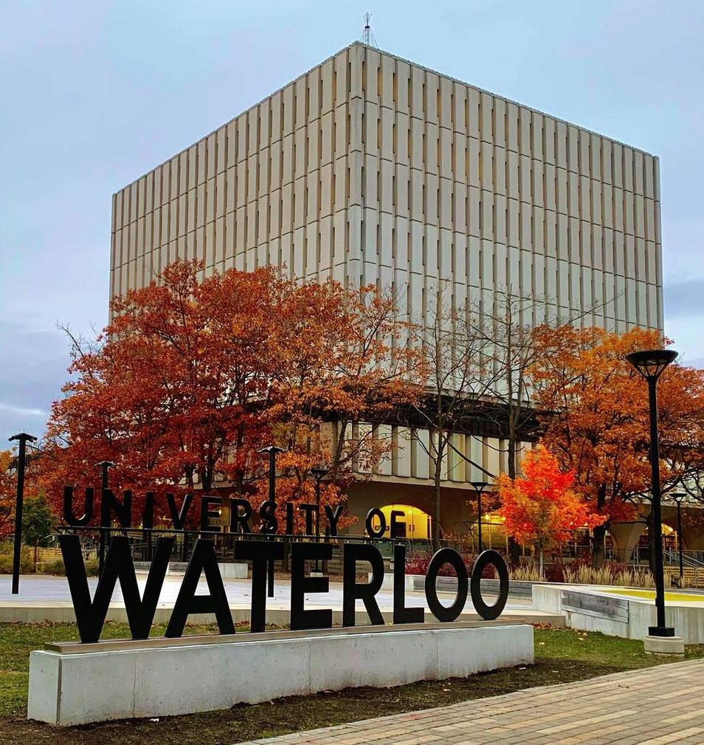
Smart agricultural system
Ishleen (20931199)
Bipinjot Kaur Hara (20896354)
Ravideep Singh (20971136)
Electrical and Computer Engineering
Photo credit: @bruce.digital

Slide 2
MOTIVATION

Slide 3
MOTIVATION
According to a prediction study, Agriculture is projected to feed a global population of 9.7 billion approximately by 2050. In 2020 alone, a boom of 60% for the agricultural produce was required to feed the population of the world. So, it is important we work to optimize the agricultural domain efficiently.
Macroeconomics, changing consumer preferences, emerging technologies and transforming supply chains are the key drivers for digital transformation in agriculture & how the challenges facing the agriculture industry worldwide could be effectively tackled by following the right approach and leveraging technology to meet the growing demand for food.

Slide 4
MOTIVATION
The recent COVID-19 crisis has further exposed the vulnerability of the agricultural landscape and raised questions about meeting the global food demands sustainably, with adverse factors at play. Again, the answer lies in achieving efficiency - producing more with less, now more than ever.
The industry will be transformed by data science and artificial intelligence. Farmers will have the tools to get the most from every acre

Slide 5
literature

Slide 6
LITERATURE
Smart agriculture monitoring system is an emerging technology concept where data from several agricultural fields ranging from small to large scale and its surrounding are collected using smart electronic sensors (WSN).
The collected data are analyzed by experts and local farmers to draw short term and long term conclusion on weather pattern, soil fertility, current quality of crops, amount of water that will be required for next week to a month etc.
We can take smart farming a step further by automating several parts of farming, for example smart irrigation and water management.
We can apply predictive algorithms on microcontrollers or SoC to calculate the amount of water and other factors affecting crops that will be required for a particular agriculture field or a specific crop.

Slide 7
LITERATURE
IT based Smart Irrigation System
From [1],
This paper presents basic information regarding automation of farm activities can transform agricultural domain from being manual and static to intelligent and dynamic leading to higher production with lesser human supervision.
The setup uses soil moisture sensors which measure the exact moisture level in soil. This value enables the system to use appropriate quantity of water which avoids over/under irrigation.
It is used to keep the farmers updated about the status of sprinklers. Also, the sensor readings are transmitted to a Thing speak channel to generate graphs for analysis.

Slide 8
LITERATURE
Smart Irrigation System using IOT
From [2],
This paper presents information about a water supply system. As fresh water is becoming scarce in today’s world, there is an urgency of adopting smart ways of irrigation.
The project describes how irrigation can be handled smartly using IoT. This project aims at saving time and avoiding problems like constant vigilance.
It also helps in conserving water by automatically providing water to the plants/fields depending on the water requirements. This system can also prove to be helpful in agriculture, parks and lawns.
The objective of this system is to detect the moisture content of the soil and depending on it sprinkle water. This entire information will be sent to the user's mobile phone.

Slide 9
DRAWBACKS IN EXISTING SYSTEMS
Current systems doesn’t employ Machine Learning to predict certain parameters like which crop would be perfect to plant.
Less variety of environmental sensors used to monitor the territorial conditions.
Very less systems focus on functioning of actuators like sprinklers, nutrient controllers etc. based on sensor data.
No robustness and maintenance in case there is some issue in the client’s devices.

Slide 10
Gap analysis and problem statement

Slide 11
GAP ANALYSIS
Meeting global food demands efficiently and quickly are a priority now. The answer hence lies in achieving efficiency- producing more with less, now more than ever.
The projects we referred to, manage one of the environmental factors for the appropriate crop.
It would be better if all the sensors are integrated into one microprocessor and data output is consolidated into one database governing everything.
Scalability- Data needs to be varied for a large number of crops so that the entire sensor network can be used on a wide scale in every terrain and not just for few particular crops.

Slide 12
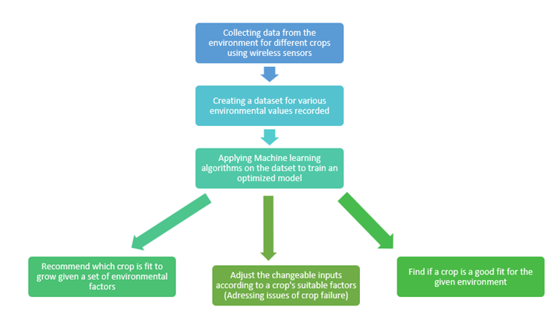
PROBLEM STATEMENT

Slide 13
Approach and methodology

Slide 14
APPROACH
We plan to develop a robust network that could sense multiple parameter values across large fields and collect that data in the form a large dataset.
The next step would be to train a Machine Learning model on the prepared dataset. We will be choosing the technique which would give us best classification evaluation metrics and would be efficient to implement.
This would help us to predict the type of crops which are best suited for a set of environmental factors as input.
Using this model, we will be answering multiple questions that would assist in solving the problem faced by agricultural industry.

Slide 15
METHODOLOGY
Set up the sensors in the agriculture field
Collected data from sensors is sent to the Micro-Processor Unit
MCU-PT sends the data to DLC100 – Home Gateway bridging the LAN and WAN
From the gateway, collected data is sent to the cloud service through a cable modem
The cloud service then sends the data onto the Remote service provider network
Remote service provider network consists od routers and switches and a basic server
Data is then sent to a central server where it is processed and stored into a Central Office Server
The server performs various ML algos and other methodologies and sends appropriate response data to the cell tower
The cell tower then broadcasts the info required to the smartphone via mail/SMS

Slide 16
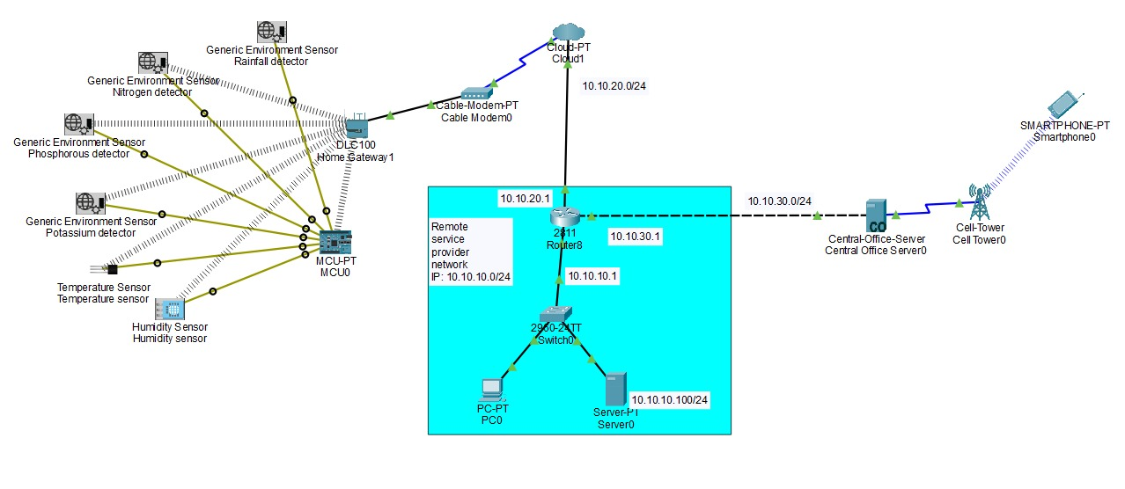
ARCHITECTURE

Slide 17
Experiments and results

Slide 18
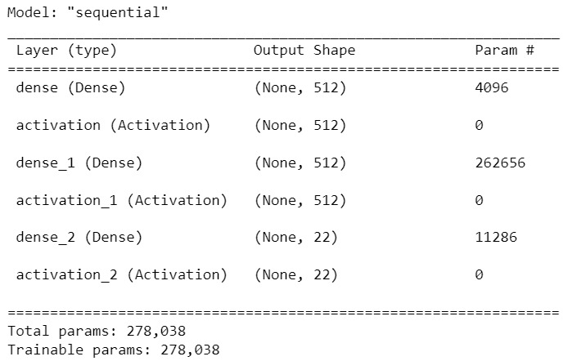
EXPERIMENTAL RESULTS
The process of collection of data is done very effectively and efficiently. The ultimate aim of the project was to give proper predictions to the agriculture workers so the crops can grow optimally and sustainably.
By hit and trial methods, we decided on a model that gave us a good accuracy and least error.

Slide 19
MODEL RESULTS
The model discussed gives us a good accuracy and predicts the labels correctly with minimized error.
The accuracy and error is as follows:
We will now discuss examples of our input and prediction output given by the model to the user’s smartphone.

Slide 20
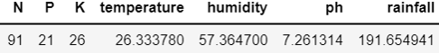
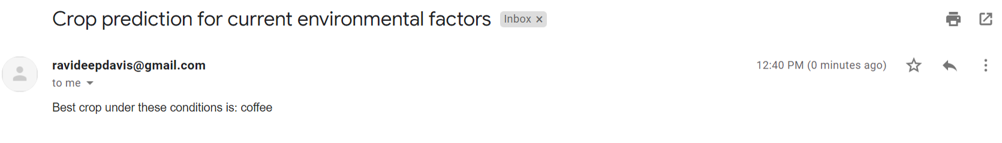
EXPERIMENT 1
Input to the model from IoT architecture:
Output of the model sent via mail

Slide 21
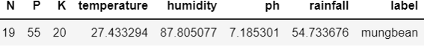
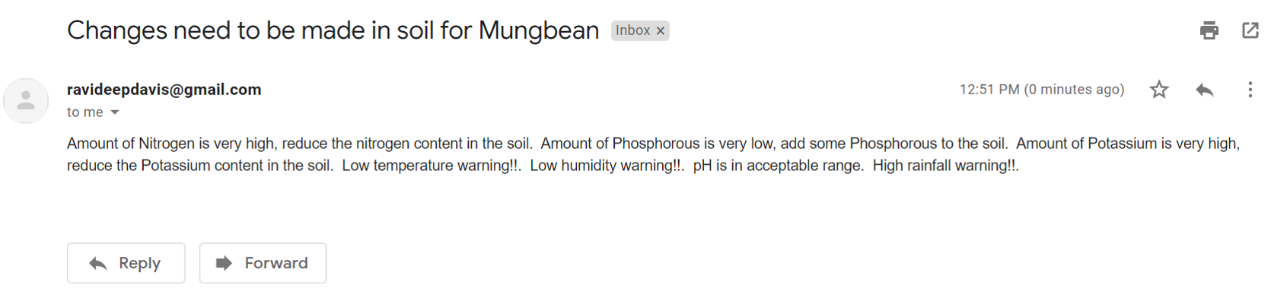
EXPERIMENT 2
Input to the model from IoT architecture:
Output of the model sent via mail

Slide 22
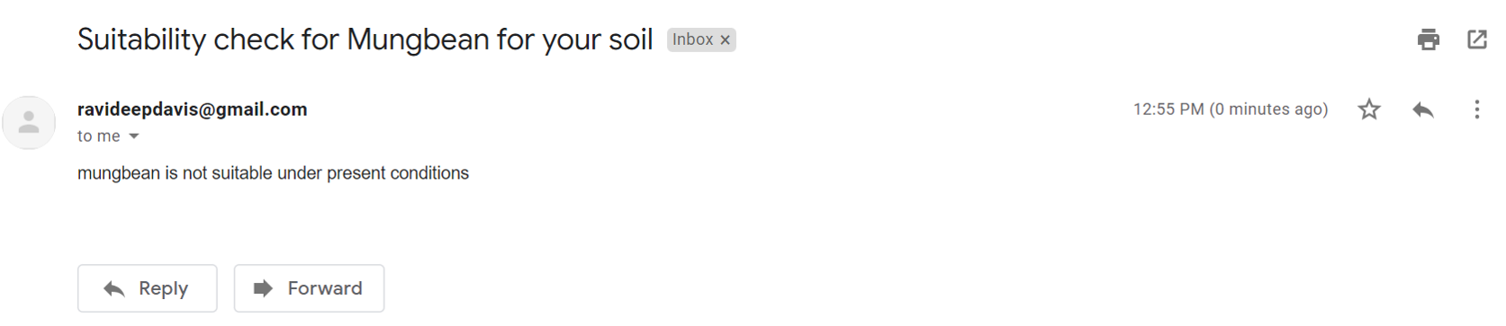
EXPERIMENT 3
Input to the model from IoT architecture:
Output of the model sent via mail

Slide 23
questions

Slide 24
Question 1
Is the system robust? How is it able to handle failure points?
At some points, system is robust.
If there is any failure in the client's device or server, there is a provision of remote service provider network. This enables us to maintain and support the client's servers and devices offsite.
System is easily scalable by attaching more MCUs. Implementation of scaling the system is a future scope for our project.
Once scaled to a large level, we would also be able to counter the sensor failures.
For eg. if humidity sensor fails in a cluster fails, we can get the required data from the humidity sensor of other cluster.
The main point of failure is during the absence of a stable internet connection. We can add a provision on local database to store the values in it but the system won't work in real-time

Slide 25
Question 2
How is data security ensured in the system?
In order to ensure the security of the data being collected from the sensors, WPA2PSK authentication is used.
This authentication ensures an added layer of protection using AES encryption protocol and hence eliminates the risk of using a shared password in the system.
Both the old and the new devices can use the wireless security standard as the authentication supports TKIP, in addition to AES.
As a future scope, the cloud used for storing the data can be used to enhance the security of the system.

Slide 26
Question 3
What are the reporting and analytics capabilities of the project?
Currently, the system is developed to accept queries discretely from farmers or farming units via wireless mode of communication i.e. emails.
The project analyzes three different types problem statements from the data processed by the ML algorithms.
The project is also not able to process the data in bulk. It processes each query separately and gives the data for one query at a time. As a future scope, accommodations need to be done in the code so that it can handle bulk queries of various types at once.
Given the database of queries collected overtime, the system will be adapted to address more problem statements.

Slide 27
conclusion

Slide 28
CONCLUSION
The project foundation lays on wireless sensor networks, SMTP and Machine Learning. We have used the Cisco Packet Tracer to simulate the network of six different types of sensors used to collect the data with WPA2PSK/ AES authentication.
In the virtual simulation of the network, we further implemented the storage of the data on a cloud and a local server. This data was then sent wirelessly to a smart phone using a cell tower from a local server.
This data was then used in the Machine Learning algorithms to derive useful insights. The data was preprocessed, and a neural network is designed to fetch the answers for the three problem statements that the project aims to answer.
The SMTP is used to receive the queries and answer these queries. Hence the project, holistically uses the different technologies available to create an ecosystem.

Slide 29
REFERENCES
[1] Srishti Rawal Department of Computer Science, VIT University "IT based Smart Irrigation System" International Journal of Computer Applications (0975 - 8887) Volume 159 - No 8, February 2017.
[2] Arif Gori 1, Manglesh Singh 2, Ojas Thanawala 3, Anupam Vishwakarma 4, Prof. Ashfaque Shaikh 5 Student, Computer Engineering, Rizvi College of Engineering, Mumbai, India1,2,3,4 Guide, Computer Engineering, Rizvi College of Engineering, Mumbai, India 5. "Smart Irrigation System using IOT" Interational Journal of Advanced Research in Computer and Communication Engineering ISO 3297:2007 Certified Vol. 6, Issue 9,September 2017.
3] Burugari, Vijay Kumar & Selvaraj, Prabha & Palaniappan, Kanmani. (2021). Smart Agriculture Using WSN and IoT. 10.4018/978-1-7998-1722-2.ch012.
[4] Siris, Vasilios & Fotiou, Nikos & Mertzianis, Alexandros & Polyzos, George. (2019). Smart application-aware IoT data collection. Journal of Reliable Intelligent Environments. 5. 1-12. 10.1007/s40860-019-00077-y.
[5] J. Doshi, T. Patel, and S. K. Bharti, ‘Smart Farming using IoT, a solution for optimally monitoring farming conditions’, Procedia Computer Science, vol. 160, pp. 746–751, Ιανουαρίου 2019.
[6] I. Ali, I. Ahmedy, A. Gani, M. U. Munir and M. H. Anisi, "Data Collection in Studies on Internet of Things (IoT), Wireless Sensor Networks (WSNs), and Sensor Cloud (SC): Similarities and Differences," in IEEE Access, vol. 10, pp. 33909-33931, 2022, doi: 10.1109/ACCESS.2022.3161929.

Slide 30
FINAL quote
“The industry will be transformed by data science and artificial intelligence. Farmers will have the tools to get the most from every acre.”

Slide 31
THANK YOU

